Slide 1
Software Testing
CSA 2010

Slide 2
Quality, Quality assurance and Quality Control
Quality:
Quality is meeting the requirement, expectation, and needs of the customer is free from the defects, lacks and substantial variants. There are standards needs to follow to satisfy the customer requirements.
Quality Assurance is known as QA and focuses on preventing defect. Quality Assurance ensures that the approaches, techniques, methods and processes are designed for the projects are implemented correctly.
Quality assurance activities monitor and verify that the processes used to manage and create the deliverables have been followed and are operative.
Quality Assurance is a proactive process and is Prevention in nature. It recognizes flaws in the process. Quality Assurance has to complete before Quality Control.
Notes:
credential:
bring a computer
die photo
wafer
:
This can be an hidden slide. I just want to use this to do my own planning.
I have rearranged Culler’s lecture slides slightly and add more slides. This covers everything he covers in his first lecture (and more) but may
We will save the fun part, “ Levels of Organization,” at the end (so student can stay awake): I will show the internal stricture of the SS10/20.
Notes to Patterson: You may want to edit the slides in your section or add extra slides to taylor your needs.

Slide 3

Quality, Quality assurance and Quality Control
Quality Control is known as QC and focuses on identifying a defect. QC ensures that the approaches, techniques, methods and processes are designed in the project are following correctly. QC activities monitor and verify that the project deliverables meet the defined quality standards.
Quality Control is a reactive process and is detection in nature. It recognizes the defects. Quality Control has to complete after Quality assurance
Notes:
credential:
bring a computer
die photo
wafer
:
This can be an hidden slide. I just want to use this to do my own planning.
I have rearranged Culler’s lecture slides slightly and add more slides. This covers everything he covers in his first lecture (and more) but may
We will save the fun part, “ Levels of Organization,” at the end (so student can stay awake): I will show the internal stricture of the SS10/20.
Notes to Patterson: You may want to edit the slides in your section or add extra slides to taylor your needs.

Slide 4
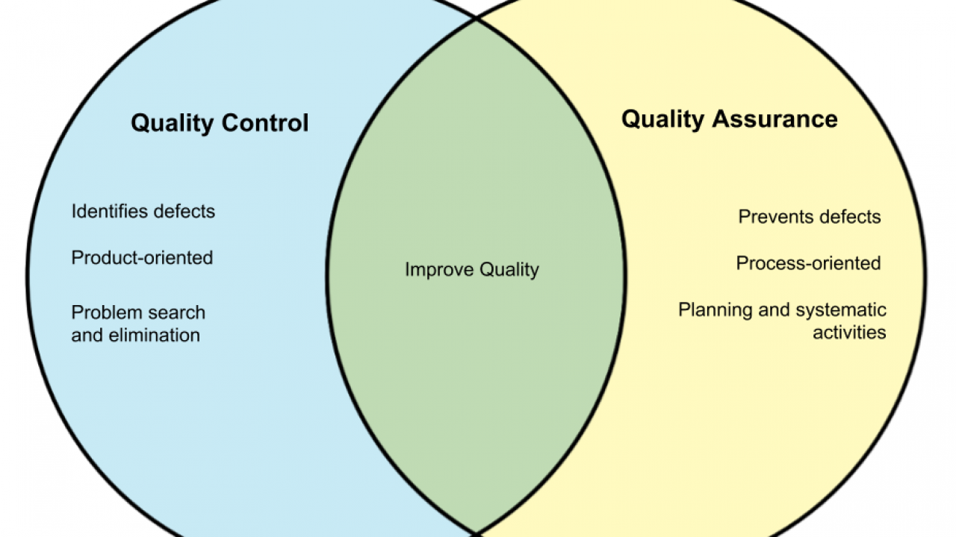
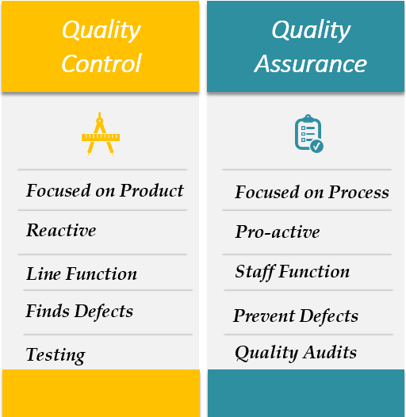
Quality, Quality assurance and Quality Control
Notes:
credential:
bring a computer
die photo
wafer
:
This can be an hidden slide. I just want to use this to do my own planning.
I have rearranged Culler’s lecture slides slightly and add more slides. This covers everything he covers in his first lecture (and more) but may
We will save the fun part, “ Levels of Organization,” at the end (so student can stay awake): I will show the internal stricture of the SS10/20.
Notes to Patterson: You may want to edit the slides in your section or add extra slides to taylor your needs.

Slide 5
Software Testing and Its Types
White Box Testing:
It is based on the knowledge about the internal logic of an application’s code.
It is also known as Glass box Testing. Internal software and code working should be known for performing this type of testing.
Under these tests are based on the coverage of code statements, branches, paths, conditions, etc.
Black Box Testing
Internal system design is not considered in this type of testing. Tests are based on the requirements and functionality.
Black-box testing is a method of software testing that examines the functionality of an application without peering into its internal structures or workings. This method of test can be applied virtually to every level of software testing: unit, integration, system and acceptance

Slide 6
Different Types Of Software Testing
Functional Testing types include:
Unit Testing
Integration Testing
System Testing
Sanity Testing
Smoke Testing
Interface Testing
Regression Testing
Beta/Acceptance Testing
Non-Functional Testing types include:
Performance Testing
Load Testing
Stress Testing
Volume Testing
Security Testing
Reliability Testing
Compatibility Testing
Usability Testing,
Localization Testing

Slide 7
Unit Testing
Testing of an individual software component or module is termed as Unit Testing. It is typically done by the programmer and not by testers, as it requires detailed knowledge of the internal program design and code. It may also require developing test driver modules or test harnesses.
Integration Testing
Testing of all integrated modules to verify the combined functionality after integration is termed as Integration Testing.
Modules are typically code modules, individual applications, client and server applications on a network, etc. This type of testing is especially relevant to client/server and distributed systems.

Slide 8
System Testing
Under System Testing technique, the entire system is tested as per the requirements. It is a Black-box type Testing that is based on overall requirement specifications and covers all the combined parts of a system.
Sanity Testing
Sanity Testing is done to determine if a new software version is performing well enough to accept it for a major testing effort or not. If an application is crashing for the initial use then the system is not stable enough for further testing. Hence a build or an application is assigned to fix it.

Slide 9
Smoke Testing
Whenever a new build is provided by the development team then the Software Testing team validates the build and ensures that no major issue exists.
The testing team ensures that the build is stable and a detailed level of testing is carried out further.
Smoke Testing checks that no show stopper defect exists in the build which will prevent the testing team to test the application in detail.
If testers find that the major critical functionality is broken down at the initial stage itself then testing team can reject the build and inform accordingly to the development team. Smoke Testing is carried out to a detailed level of any Functional or Regression Testing.

Slide 10
Graphical User Interface (GUI) Testing
The objective of this GUI Testing is to validate the GUI as per the business requirement. The expected GUI of the application is mentioned in the Detailed Design Document and GUI mockup screens.
The GUI Testing includes the size of the buttons and input field present on the screen, alignment of all text, tables, and content in the tables.
It also validates the menu of the application, after selecting different menu and menu items.
It validates that the page does not fluctuate and the alignment remains same after hovering the mouse on the menu or sub-menu.

Slide 11
Regression Testing is defined as a type of software testing to confirm that a recent program or code change has not adversely affected existing features.
Regression Testing is nothing but a full or partial selection of already executed test cases which are re-executed to ensure existing functionalities work fine.
Benefits of Regression Testing
Increase chances of detecting bugs caused due to new changes introduced in the software
Helps in identifying undesirable side effects that might have been caused due to a new operating environment
Ensures better performing software due to early identification of bugs and errors
Highly beneficial in situations when continuous changes are introduced in the product
Helps in maintaining high product quality

Slide 12
Acceptance Testing / BETA Testing
An Acceptance Test is performed by the client and verifies whether the end to end the flow of the system is as per the business requirements or not and if it is as per the needs of the end-user. Client accepts the software only when all the features and functionalities work as expected.
It is the last phase of the testing, after which the software goes into production. This is also called User Acceptance Testing (UAT).
Alpha Testing
It is the most common type of testing used in the Software industry. The objective of this testing is to identify all possible issues or defects before releasing it into the market or to the user.
Alpha Testing is carried out at the end of the software development phase but before the Beta Testing. Still, minor design changes may be made as a result of such testing.
Alpha Testing is conducted at the developer’s site. In-house virtual user environment can be created for this type of testing.

Slide 13
Performance Testing
Testing the response time and stability of an application by applying load is called Performance Testing.
Performance Testing should be carried out when
Product is stable
After completion of Functionality testing
After completion of system testing
Types of Performance Testing:
Load Testing
Stress Testing
Stability Testing
Volume Testing
Scalability Testing

Slide 14
Load Testing:
Testing the behavior of the Application by applying load less than or equal to desired load
Desired Load → 1000 users → Goal is: Response time= 5 sec
Stress Testing:
Testing the behavior of the Application by applying load greater than or equal to desired load
Stability Testing (Time):
Testing Application’s stableness for a particular period of time by applying load.

Slide 15
Volume Testing (Data):
Testing the behavior of the Application by applying huge volumes of data is called V.T
Scalability Testing:
Testing the behavior of the Application by increasing/decreasing the scales in a particular intervals is called S.T
Scenario 1: Downward Scalability
Goal = Response time 5 sec for 80 users
100 users → 8 sec, 70 users→ 7 sec, 80 users→ 5 sec
Scenario 1: Upward Scalability
100 users → 3 sec, 110 users→ 3 sec, 120 users→ 5 sec
150 users → System thrash

Slide 16
Scalability Testing
The objective is to find out the maximum capability of the product parameters.
Scalability Testing is a non-functional test methodology in which an application’s performance is measured in terms of its ability to scale up or scale down the number of user requests or other such performance measure attributes.
Scalability testing can be performed at a hardware, software or database level.
If this testing is done properly, major errors with respect to performance in the software, hardware, and database can be uncovered in the developed applications.
Notes:
credential:
bring a computer
die photo
wafer
:
This can be an hidden slide. I just want to use this to do my own planning.
I have rearranged Culler’s lecture slides slightly and add more slides. This covers everything he covers in his first lecture (and more) but may
We will save the fun part, “ Levels of Organization,” at the end (so student can stay awake): I will show the internal stricture of the SS10/20.
Notes to Patterson: You may want to edit the slides in your section or add extra slides to taylor your needs.

Slide 17
Reliability Testing
Reliability testing is defined as a software testing type, that checks whether the software can perform a failure-free operation for a specified period of time in a specified environment.
Reliability testing in software assures that the product is fault free and is reliable for its intended purpose.
Reliability is achieved by focusing on the following activities.
Defined engineering process
Review of work products at each stage
Change management procedures.
Notes:
credential:
bring a computer
die photo
wafer
:
This can be an hidden slide. I just want to use this to do my own planning.
I have rearranged Culler’s lecture slides slightly and add more slides. This covers everything he covers in his first lecture (and more) but may
We will save the fun part, “ Levels of Organization,” at the end (so student can stay awake): I will show the internal stricture of the SS10/20.
Notes to Patterson: You may want to edit the slides in your section or add extra slides to taylor your needs.

Slide 18
Compatibility Testing
It is a testing type in which it validates how software behaves and runs in a different environment, web servers, hardware, and network environment.
Compatibility testing ensures that software can run on a different configuration, different database, different browsers, and their versions. Compatibility testing is performed by the testing team.
Usability Testing
Under Usability Testing, User-friendliness check is done. The application flow is tested to know if a new user can understand the application easily or not, Proper help documented if a user gets stuck at any point. Basically, system navigation is checked in this testing.

Slide 19
Software Testing Life Cycle (STLC)
What is Software Testing Life Cycle (STLC)?
Software Testing Life Cycle (STLC) is a sequence of specific activities conducted during the testing process to ensure software quality goals are met.
STLC involves both verification and validation activities. Contrary to popular belief, Software Testing is not just a single/isolate activity, i.e. testing. It consists of a series of activities carried out methodologically to help certify your software product.

Slide 20
STLC Phases
There are following six major phases in every Software Testing Life Cycle Model (STLC Model):
Requirement Analysis
Test Planning
Test case development
Test Environment setup
Test Execution
Test Cycle closure

Slide 21
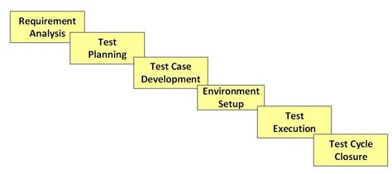
STLC Model Phases

Slide 22
What is Entry and Exit Criteria in STLC?
Entry Criteria: Entry Criteria gives the prerequisite items that must be completed before testing can begin.
Exit Criteria: Exit Criteria defines the items that must be completed before testing can be concluded
You have Entry and Exit Criteria for all levels in the Software Testing Life Cycle (STLC)

Slide 23
Requirement Phase Testing
It studies the requirements from a testing point of view to identify testable requirements and the QA team may interact with various stakeholders to understand requirements in detail. Requirements could be either functional or non-functional.
Activities in Requirement Phase Testing
Identify types of tests to be performed. Gather details about testing priorities and focus.
Prepare Requirement Traceability Matrix (RTM).
Identify test environment details where testing is supposed to be carried out.
Automation feasibility analysis (if required).

Slide 24
Test Planning in STLC
Test Planning in STLC is a phase in which a Senior QA manager determines the test plan strategy along with efforts and cost estimates for the project.
Moreover, the resources, test environment, test limitations and the testing schedule are also determined. The Test Plan gets prepared and finalized in the same phase.
Test Planning Activities
Preparation of test plan/strategy document for various types of testing
Test tool selection
Test effort estimation
Resource planning and determining roles and responsibilities.
Training requirement

Slide 25
Test Case Development Phase
The Test Case Development Phase involves the creation, verification and rework of test cases & test scripts after the test plan is ready. Initially, the Test data is identified then created and reviewed and then reworked based on the preconditions.
Then the QA team starts the development process of test cases for individual units.
Test Case Development Activities
Create test cases, automation scripts (if applicable)
Review and baseline test cases and scripts
Create test data (If Test Environment is available)

Slide 26
Test Environment Setup
It decides the software and hardware conditions under which a work product is tested. It is one of the critical aspects of the testing process and can be done in parallel with the Test Case Development Phase.
Test team may not be involved in this activity if the development team provides the test environment.
Test Environment Setup Activities
Understand the required architecture, environment set-up and prepare hardware and software requirement list for the Test Environment.
Setup test Environment and test data
Perform smoke test on the build

Slide 27
Test Execution Phase
It is carried out by the testers in which testing of the software build is done based on test plans and test cases prepared.
The process consists of test script execution, test script maintenance and bug reporting. If bugs are reported then it is reverted back to development team for correction and retesting will be performed.
Test Execution Activities
Execute tests as per plan
Document test results, and log defects for failed cases
Map defects to test cases in RTM
Retest the Defect fixes
Track the defects to closure

Slide 28
Test Cycle Closure
Test Cycle Closure phase is completion of test execution which involves several activities like test completion reporting, collection of test completion matrices and test results.
Testing team members meet, discuss and analyze testing artifacts to identify strategies that have to be implemented in future, taking lessons from current test cycle.
The idea is to remove process bottlenecks for future test cycles.

Slide 29
LAB EXERCISES

Slide 30
Exp 1: Design and develop a program in a language of your choice to solve the triangle problem defined as follows: Accept three integers which are supposed to be the three sides of a triangle and determine if the three values represent an equilateral triangle, isosceles triangle, scalene triangle, or they do not form a triangle at all. Assume that the upper limit for the size of any side is 10. Derive test cases for your program based on boundary-value analysis, execute the test cases and discuss the results.
AIM | To derive test cases using Boundary Value Analysis Technique
PROGRAM TO TEST | Triangle Problem
TECHNIQUE USED | Boundary Value Analysis
TYPE OF TESTING | Black Box Testing

Slide 31
TC Id | Test Case Description | Input Data |  |  | Expected Output | Actual Output | Status
 |  | A | b | C
1 | Enter nominal for a & b, min for c | 5 | 5 | 1 | Isosceles
2 | Enter nominal for a & b, min+ for c | 5 | 5 | 2 | Isosceles
3 | Enter nominal for a & b, nominal for c | 5 | 5 | 5 | Equilateral
4 | Enter nominal for a & b, max- for c | 5 | 5 | 9 | Isosceles
5 | Enter nominal for a & b, max for c | 5 | 5 | 10 | Not a Triangle
6 | Enter nominal for a & c, min for b | 5 | 1 | 5 | Isosceles
7 | Enter nominal for a & c, min+ for b | 5 | 2 | 5 | Isosceles
8 | Enter nominal for a & c, max- for b | 5 | 9 | 5 | Isosceles
9 | Enter nominal for a & c, max for b | 5 | 10 | 5 | Not a Triangle
10 | Enter nominal for b & c, min for a | 1 | 5 | 5 | Isosceles
11 | Enter nominal for b & c, min+ for a | 2 | 5 | 5 | Isosceles
12 | Enter nominal for b & c, max- for a | 9 | 5 | 5 | Isosceles
13 | Enter nominal for b & c, max for a | 10 | 5 | 5 | Not a Triangle

Slide 32
TEST REPORT
No of Test Cases Executed:
No of Defects Raised:
No of Test Cases Passed:
No of Test Cases Failed:

Slide 33
Exp 2: Design and develop a program in a language of your choice to solve the triangle problem defined as follows: Accept three integers which are supposed to be the three sides of a triangle and determine if the three values represent an equilateral triangle, isosceles triangle, scalene triangle, or they do not form a triangle at all. Derive test cases for your program based on decision-table approach, execute the test cases and discuss the results
AIM | To derive test cases using Decision Table Technique
PROGRAM TO TEST | Triangle Problem
TECHNIQUE USED | Decision Table
TYPE OF TESTING | Black Box Testing

Slide 34
DECISION TABLE FOR TRIANGLE PROBLEM
Conditions | Condition Entries (Rules)
 | R 1 | R 2 | R 3 | R 4 | R 5 | R 6 | R 7 | R 8 | R 9 | R 10 | R 11
C1: a<b+c? | F | T | T | T | T | T | T | T | T | T | T
C2: b<a+c? | -- | F | T | T | T | T | T | T | T | T | T
C3: c<a+b? | -- | -- | F | T | T | T | T | T | T | T | T
C4: a=b? | -- | -- | -- | F | T | T | T | F | F | F | T
C5: a=c? | -- | -- | -- | T | F | T | F | T | F | F | T
C6: b=c? | -- | -- | -- | T | T | F | F | F | T | F | T
Actions | Action Entries
a1: Not a Triangle | X | X | X
a2: Scalene |  |  |  |  |  |  |  |  |  | X
a3: Isosceles |  |  |  |  |  |  | X | X | X
a4: Equilateral |  |  |  |  |  |  |  |  |  |  | X
a5: Impossible |  |  |  | X | X | X

Slide 35
Decision table Test Cases for Triangle problem
TC ID | Test Case Description | a | B | c | Expected Output | Actual Output | Status
1 | Testing for Rule 1 | 4 | 1 | 2 | Not a Triangle
2 | Testing for Rule 2 | 1 | 4 | 2 | Not a Triangle
3 | Testing for Rule 3 | 1 | 2 | 4 | Not a Triangle
4 | Testing for Rule 11 | 5 | 5 | 5 | Equilateral
5 | Testing for Rule 7 | 2 | 2 | 3 | Isosceles
6 | Testing for Rule 8 | 2 | 3 | 2 | Isosceles
7 | Testing for Rule 9 | 3 | 2 | 2 | Isosceles
8 | Testing for Rule 10 | 3 | 4 | 5 | Scalene

Slide 36
TEST REPORT
No of Test Cases Executed:
No of Defects Raised:
No of Test Cases Passed:
No of Test Cases Failed:

Slide 37
EXP 3: Design, develop, code and run the program in any suitable language to solve the commission problem. Analyze it from the perspective of boundary value testing, derive different test cases, execute these test cases and discuss the test results.
AIM | To derive test cases using Boundary Value Analysis Technique
PROGRAM TO TEST | Commission Problem
TECHNIQUE USED | Boundary Value Analysis
TYPE OF TESTING | Black Box Testing

Slide 38
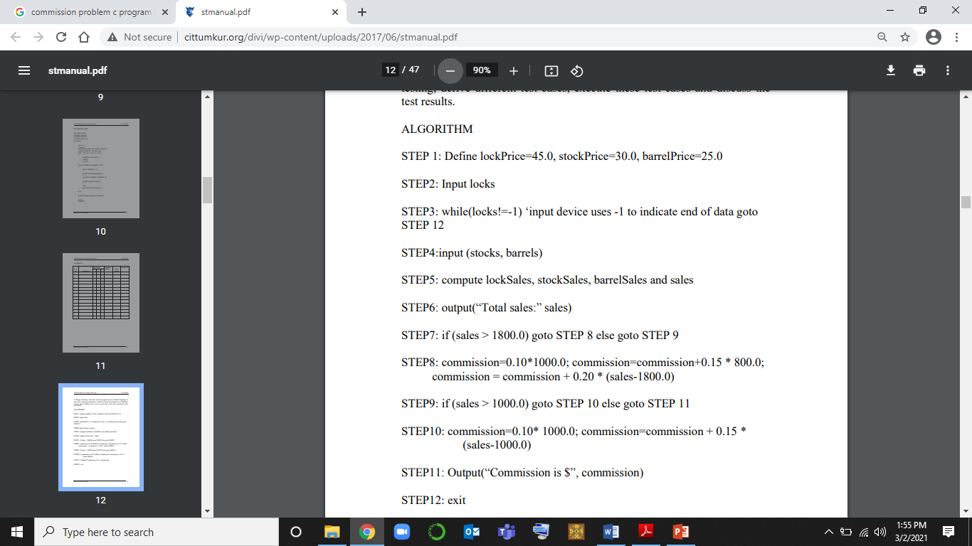

Slide 39
TC Id | Test Case Description | Input Data |  |  | Sales | Expected Output(commission) | Actual Output (sales, commission) | Status
 |  | Locks L | Stocks S | Barrels B
1 | Enter nominal for L, S and min for B | 35 | 40 | 1 | 2800 | 420
2 | Enter nominal for L, S and min + for B | 35 | 40 | 2 | 2825 | 425
3 | Enter nominal for L, S and nominal for B | 35 | 40 | 45 | 3900 | 640
4 | Enter nominal for L, S and max- for B | 35 | 40 | 89 | 5000 | 860
5 | Enter nominal for L, S and max for B | 35 | 40 | 90 | 5025 | 865
6 | Enter nominal for L, B and min for S | 35 | 1 | 45 | 2730 | 406
7 | Enter nominal for L, B and min+ for S | 35 | 2 | 45 | 2760 | 412
8 | Enter nominal for L, B and max- for S | 35 | 79 | 45 | 5070 | 874

Slide 40
9 | Enter nominal for L, B and max for S | 35 | 80 | 45 | 5100 | 880
10 | Enter nominal for B, S and min for L | 1 | 40 | 45 | 2370 | 334
11 | Enter nominal for B, S and min+ for L | 2 | 40 | 45 | 2415 | 343
12 | Enter nominal for B, S and max- for L | 69 | 40 | 45 | 5430 | 946
13 | Enter nominal for B, S and max for L | 70 | 40 | 45 | 5475 | 955

Slide 41
TEST REPORT
No of Test Cases Executed:
No of Defects Raised:
No of Test Cases Passed:
No of Test Cases Failed:

Slide 42
Exp 4:Design, develop, code and run the program in any suitable language to solve the commission problem. Analyze it from the perspective of Decision table testing, derive different test cases, execute these test cases and discuss the test results.
AIM | To derive test cases using Decision Table Technique
PROGRAM TO TEST | Commission Problem
TECHNIQUE USED | Decision Table
TYPE OF TESTING | Black Box Testing

Slide 43
Decision Table for Commission Problem
Conditions | Condition Entries (Rules)
C1: 1≤locks≤70? | F | T | T | T | T | T | T
C2: 1≤stocks≤80? | -- | F | T | T | T | T | T
C3: 1≤barrels≤90? | -- | -- | F | F | T | T | T
C4: sales>1800? | -- | -- | -- | -- | T | F | F
C5: sales>1000? | -- | -- | -- | -- | -- | T | F
C6: sales≤1000? | -- | -- | -- | -- | -- | -- | T
Actions | Action Entries
a1: com1 = 0.10*Sales |  |  |  |  |  |  | X
a2: com2 = com1+0.15*(sales-1000) |  |  |  |  |  | X
a3: com3 = com2+0.20*(sales-1800) |  |  |  |  | X
a4: Invalid Locks input | X
a4: Invalid Stocks input |  | X
a4: Invalid Barrels input |  |  | X

Slide 44
Decision Table Test Cases
TC ID | Test Case Description | Locks | Stocks | Barrels | Expected Output | Actual Output | Status
1 | Enter Invalid for locks and valid for stocks and barrels | -2 | 40 | 45 | Value of locks not in the range 1..70
2 | Enter Invalid for locks and valid for stocks and barrels | 90 | 40 | 45 | Value of locks not in the range 1..70
3 | Enter Invalid for stocks and valid for locks and barrels | 35 | -3 | 45 | Value of stocks not in the range 1..80
4 | Enter Invalid for stocks and valid for locks and barrels | 35 | 100 | 45 | Value of stocks not in the range 1..80

Slide 45
Decision Table Test Cases
5 | Enter Invalid for barrels and valid for locks and stocks | 35 | 40 | -10 | Value of barrels not in the range 1..80
6 | Enter Invalid for barrels and valid for locks and stocks | 35 | 40 | 150 | Value of barrels not in the range 1..80
7 | Enter inputs where sales <1000 | 5 | 5 | 5 | Sales:500 | a1:50
8 | Enter inputs where sales >1000 | 15 | 15 | 15 | Sales:1500 | a2: 175
9 | Enter inputs where sales >1800 | 25 | 25 | 25 | Sales:2500 | a3: 360

Slide 46
EXERCISE-5 NextDate Problem using Boundary Value Analysis
Problem Definition:
"Next Date" is a function consisting of three variables like: month, date and year. It returns the date of next day as output. It reads current date as input date. The constraints are
C1: 1 ≤ month ≤ 12 C2: 1 ≤ day ≤ 31 C3: 1812 ≤ year ≤ 2020.
If any one condition out of C1, C2 or C3 fails, then this function produces an output "value of month not in the range 1...12".
Since many combinations of dates can exist, hence we can simply display one message for this function: "Invalid Input Date".
A very common and popular problem occurs if the year is a leap year. We have taken into consideration that there are 31 days in a month. But what happens if a month has 30 days or even 29 or 28 days?
A year is called as a leap year if it is divisible by 4.

Slide 47
#include<stdio.h>
#include<ctype.h>
int check(int day,int month)
{
if((month==4||month==6||month==9 ||month==11) && day==31)
return 1;
else
return 0;
}
int isleap(int year)
{
if (year % 400 == 0 || (year % 100 != 0 && year % 4 == 0))
return 1;
else
return 0;
}

Slide 48
int main()
{
int day, month, year, tomm_day, tomm_month, tomm_year;
char flag;
do
{
flag='y';
printf("\n Enter the today's date in the form of dd mm yyyy \n");
scanf("%d%d%d",&day,&month,&year);
tomm_month=month;
tomm_year= year;
if(day<1 || day>31)
{
printf("value of day, not in the range 1...31\n");
flag='n';
}
if(month<1 || month>12)
{
printf("value of month, not in the range 1....12\n");
flag='n'; }

Slide 49
else if(check (day,month))
{
printf("value of day, not in the range day<=30");
flag='n';
}
if(year<=1812 || year>2020)
{
printf("value of year, not in the range 1812.......2020\n");
flag='n';
}
if(month==2)
{
if(isleap(year) && day>29)
{
printf("invalid date input for leap year");
flag='n';
}

Slide 50
else if(!(isleap(year))&& day>28)
{
printf("invalid date input for not a leap year");
flag='n';
}
}
}
}
while(flag=='n');

Slide 51
switch (month)
{
case 1:
case 3:
case 5:
case 7:
case 8:
case 10:if(day<31)
tomm_day=day+1;
else
{
tomm_day=1;
tomm_month=month+1;
}
break;

Slide 52
case 4:
case 6:
case 9:
case 11: if(day<30)
tomm_day=day+1;
else
{
tomm_day=1;
tomm_month=month+1;
}
break;

Slide 53
case 12: if(day<31)
tomm_day=day+1;
else
{
tomm_day=1;
tomm_month=1;
if(year==2020)
{
printf("the next day is out of boundary value of year\n");
return 0;
}
else
tomm_year=year+1;
}
break;

Slide 54
case 2:
if(day<28)
tomm_day= day+1;
else if(isleap(year) && day==28)
tomm_day=day+1;
else if(day==28 || day==29)
{
tomm_day=1;
tomm_month=3;
}
break;
}
printf("next day is : %d %d %d",tomm_day, tomm_month, tomm_year);
return 0;
}

Slide 55
BOUNDARY VALUE TESTING
The constraints are
C1: 1 ≤ month ≤ 12
C2: 1 ≤ day ≤ 31
C3: 1900 ≤ year ≤ 2024
The Next Date program takes date as input and checks it for validity. If it is valid, it returns the next date as its output.
Here we have three inputs for the program, hence n = 3.
Since BVA yields (4n + 1) test cases according to single fault assumption theory,
hence we can say that the total number of test cases will be (4*3+1)=12+1=13.
The boundary value test cases are
C1: 1 ≤ month ≤ 12
C2: 1 ≤ day ≤ 31
C3: 1900 ≤ year ≤ 2024

Slide 56
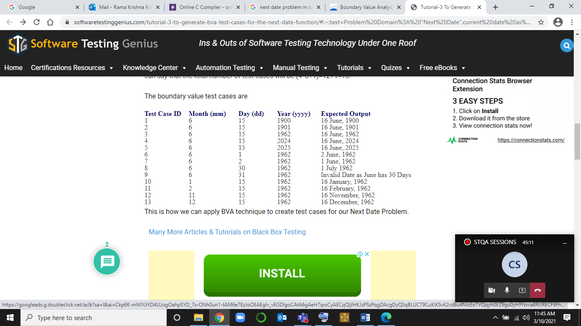

Slide 57
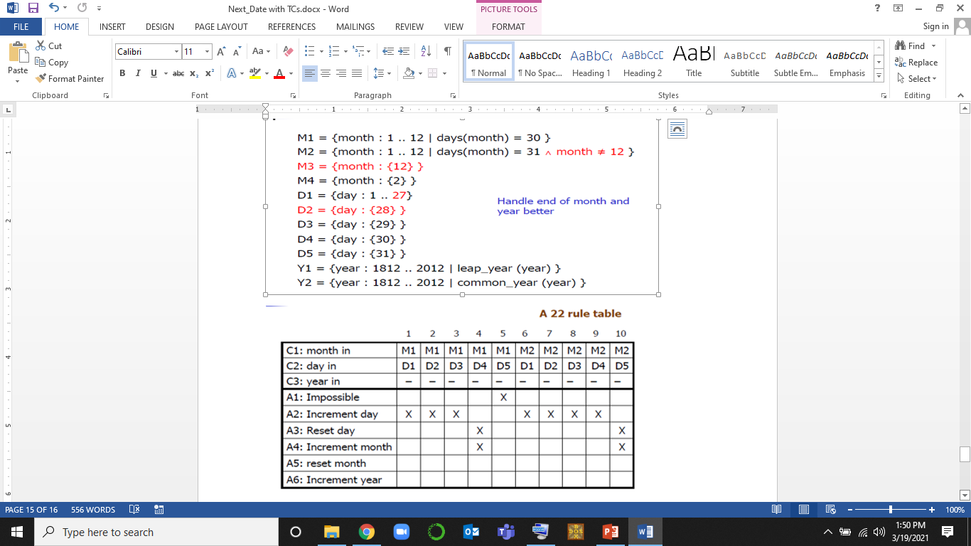
Exercise 6: Decision Table for Nextdate problem

Slide 58
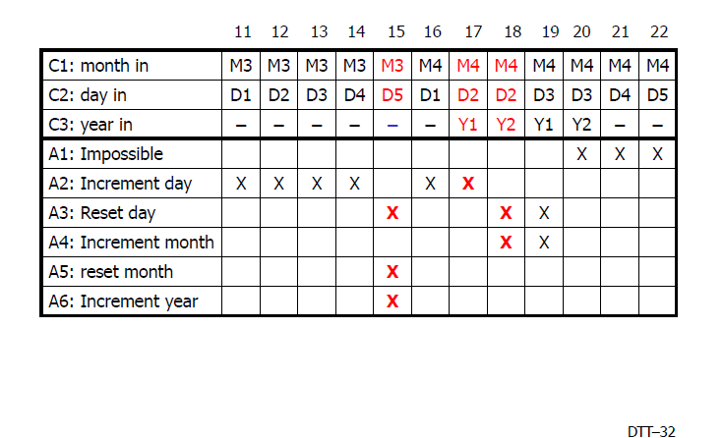

Slide 59
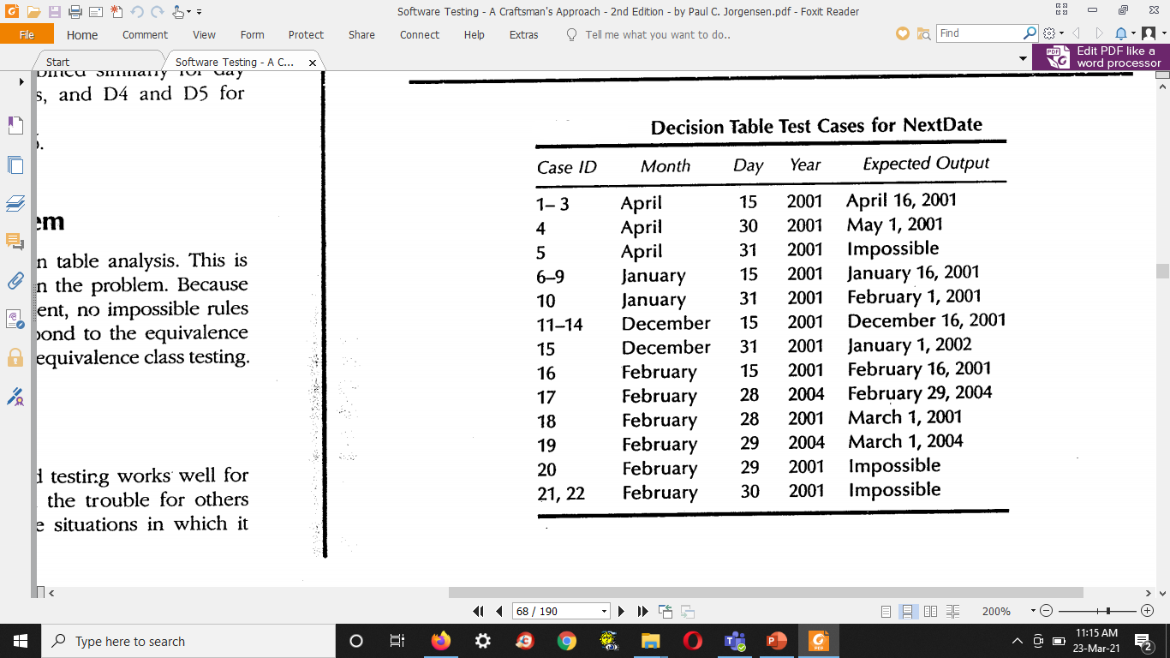
DECISION TABLE TEST CASES

